Slide 1

Indian Mutual Fund Analytics & Performance Report
Data Period: January 2022 – December 2025
Prepared By: Quantitative Analytics Team
Date: June 2026

Slide 2

Problem & Objective
Analyzing Indian Mutual Fund Performance and Market Trends
Problem
Objective
•
Understanding the complex dynamics of the Indian mutual fund industry, including performance, risk, and investor behavior, is crucial for informed decision-making.
•
This report provides a comprehensive quantitative analysis of India's mutual fund industry from January 2022 to December 2025, evaluating 40 schemes across various dimensions.

Slide 3
Data Sources & Quality
Robust Data Foundation for Reliable Insights
Data Sources
Data Quality
•
Analysis based on 13 structured datasets from AMFI and proprietary systems, including NAV history (46,000+ records), investor transactions (32,778), and AUM data.
•
Day-1 audit confirmed zero missing values, zero duplicate records, and full AMFI code consistency across all fund-level tables, ensuring high data integrity.

Slide 4




ETL Pipeline & Methodology
Automated and Reproducible Data Processing
1. Ingest & Clean
2. Transform
3. Analytical Output
Automated ingestion of 13 CSV datasets using Python/Pandas with strict type-casting and validation.
Vectorized computations for returns and risk metrics. Joining analytical fact tables on AMFI codes.
Generation of clean analytical tables for downstream visualization and performance scoring.
Key Metrics Computed
Return:
CAGR (1yr, 3yr, 5yr)
Risk:
Sharpe, Sortino, Alpha, Beta
Stability:
Max Drawdown (MDD)
Concentration:
Sector HHI Index
Scoring:
Composite Fund Scorecard (0-100)
Correlation:
Pearson NAV Matrix

Slide 5
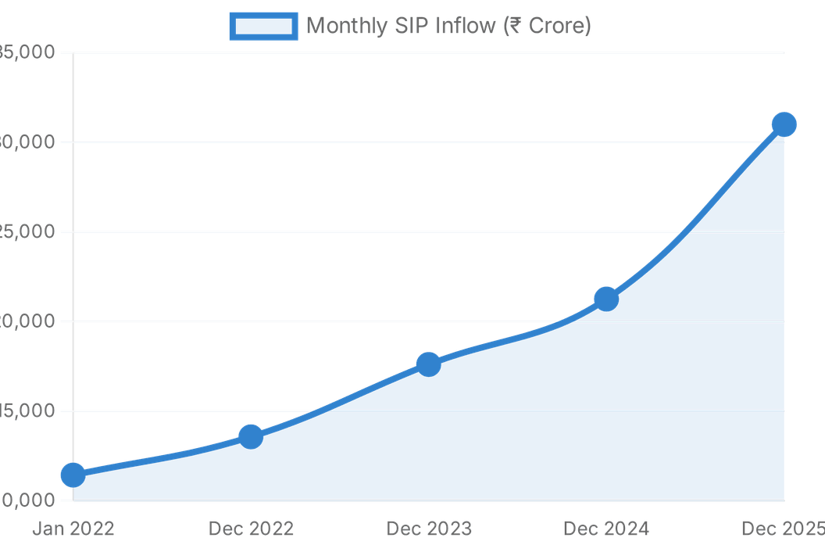
EDA Highlights: Market Growth Trends
Deepening Retail Participation and Industry Expansion
170% ↑
SIP Inflow Surge
Monthly SIP inflows grew from ₹11,438 Cr in Jan 2022 to a record ₹31,002 Cr by Dec 2025, signaling a massive shift in retail investment habits.
26 Crore
Total Industry Folios
The industry nearly doubled its reach from 13.3 Crore folios to ~26 Crore, with Equity folios serving as the primary growth engine.
Source: AMFI Data (2022-2025)

Slide 6



EDA Highlights: AUM & Sectoral Inflows
Dominance of Large Funds and Liquid Categories
AUM Growth by Fund House
Category-wise Net Inflows
SBI Mutual Fund maintained its leadership position, reaching approximately ₹12.5 Lakh Cr.
Liquid Funds dominated net inflows, attracting ₹33,000–42,000 Cr per month in FY 2024-25.
ICICI Prudential MF and HDFC Mutual Fund follow closely as top industry players.
Sectoral/Thematic Funds led equity inflows at approximately ₹8,000–10,000 Cr per month.
Mirae Asset MF registered the strongest percentage growth, driven by top-performing schemes.
Flexi Cap and Large & Mid Cap categories also showed robust investor interest.
Insight: Institutional cash management drives Liquid fund dominance, while retail equity appetite is increasingly shifting towards Sectoral and Flexi Cap mandates.

Slide 7

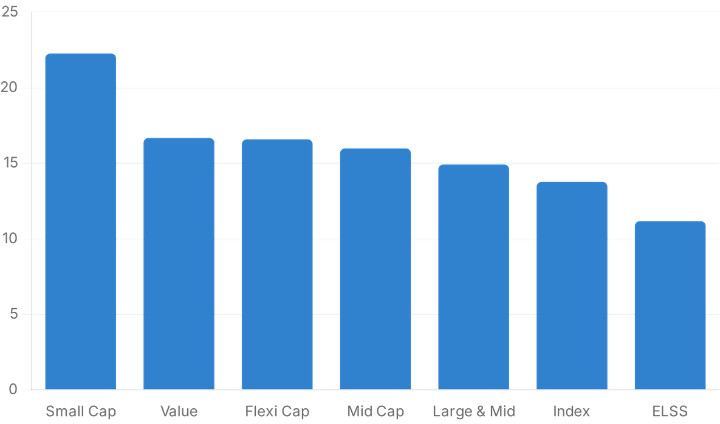
Performance Metrics: Returns & Risk
Identifying Efficient Investment Avenues (2022-2025)
Key Risk-Return Insights
Top Performers: Small Cap funds delivered the highest average 1-year return at 22.26%, followed by Value (16.67%) and Flexi Cap (16.58%).
Low-Risk Quadrant: Liquid and Short Duration funds clustered in the low-risk quadrant, providing stability with minimal drawdown.
Return Premia: Small and Mid Cap funds offered significant return premia, albeit with increased annualized volatility (18–22% std dev).
Source: Indian Mutual Fund Analytics Report, Page 15
Average 1-Year Returns by Category (%)

Slide 8

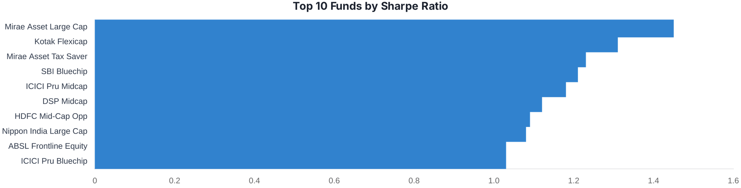
Performance Metrics: Sharpe & Top Funds
Superior Risk-Adjusted Returns and Composite Rankings
Rank
Fund Name
House
Score
5yr CAGR
Sharpe
Alpha
1
Mirae Asset Large Cap Fund
Mirae Asset MF
100.0
30.97%
1.45
0.27
2
ICICI Pru Midcap Fund
ICICI Prudential MF
94.44
32.83%
1.18
0.29
3
Kotak Flexicap Fund
Kotak Mahindra MF
94.09
30.91%
1.31
0.27
4
HDFC Mid-Cap Opportunities
HDFC Mutual Fund
92.35
30.12%
1.09
0.27
5
ICICI Pru Bluechip Fund
ICICI Prudential MF
91.31
23.30%
1.03
0.21

Slide 9
Investor Analytics Dashboard Overview
Consolidated Transactional Insights (32,778 Records)
32,778
₹3,522 Cr
60%
TOTAL TRANSACTIONS
TOTAL VALUE
SIP SHARE
₹1.07 Lakh
12
₹208 Cr
AVG TRANSACTION
ACTIVE STATES
AVG MONTHLY VOL
Note: Data reflects consolidated investor activity across 12 active states as of June 2026.

Slide 10

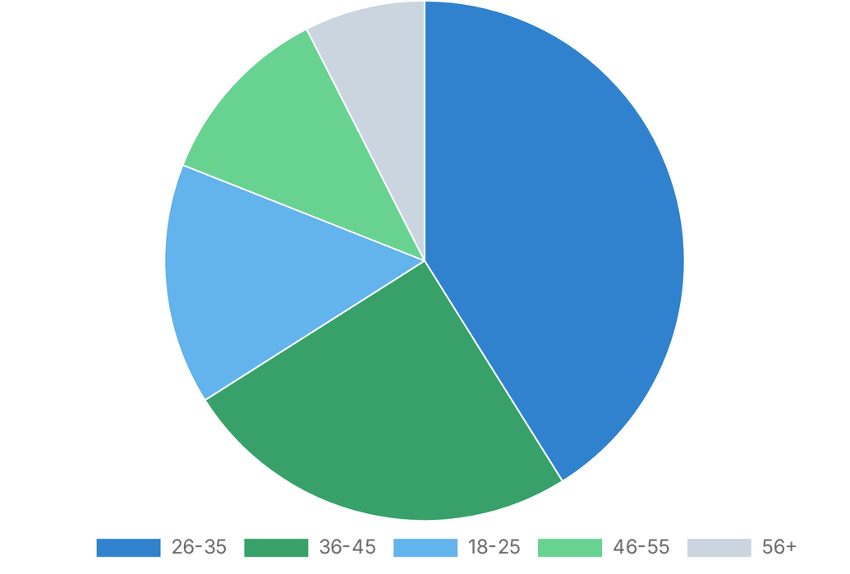


Investor Analytics: Demographics & Geography
Understanding the Modern Indian Investor Profile
Geographic Distribution
Punjab and Tamil Nadu lead the investment chart at approximately ₹3.16 Cr per state.
Madhya Pradesh (₹3.08 Cr), Rajasthan (₹3.0 Cr), and Gujarat (₹3.0 Cr) follow closely.
City Tier & Reach
T30 Cities account for 66.3% of transaction volume.
B30 Cities contribute 33.7%, reflecting significant expansion into semi-urban markets.
Key Demographic Insight
Investor Age Group Distribution (%)
The 26–35 cohort leads with 41.1% of transactions, signaling a young, digitally-native investor base.

Slide 11
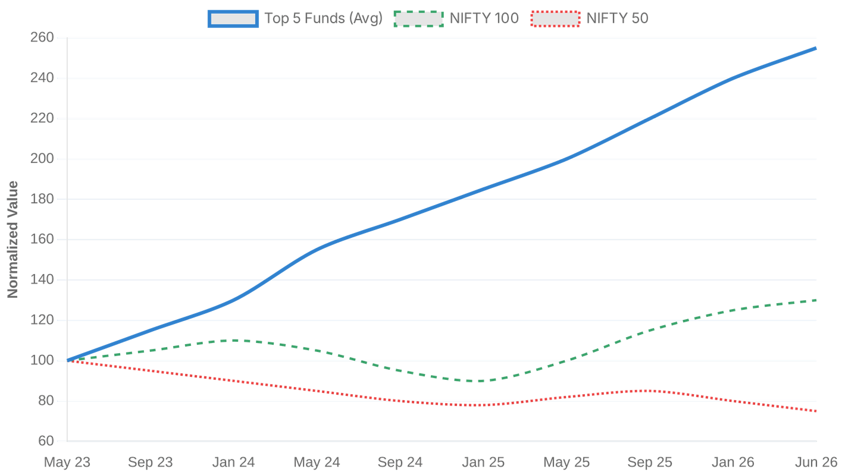
Benchmark Comparison
Top 5 Funds vs NIFTY50 & NIFTY100 (3-Year Window)
Key Observations
Alpha Generation: All top 5 funds significantly outperformed both indices, reaching 220-260 points.
Index Lag: NIFTY50 underperformed materially, dropping below 80 at its 2024 nadir.
Leadership: Mirae Asset Large Cap (Fund 148567) maintained the leading position for most of the period.
Recovery: NIFTY100 showed strong recovery from mid-2025, reaching ~130 by June 2026.
Source: Performance Master & AMFI Benchmarks
Normalized Growth (Base = 100) | May 2023 - June 2026

Slide 12


Key Findings & Recommendations
Strategic Insights for Investors and Fund Managers
Key Findings
Recommendations
SIP Growth: Monthly inflows surged 170% to ₹31,002 Cr, reflecting deep retail equity participation.
Core Holdings: Anchor portfolios with high-scoring Large/Flexi-Cap funds for benchmark-beating stability.
Market Expansion: Total folios nearly doubled to 26 Crore, driven by a young, digitally engaged demographic.
Satellite Allocation: Allocate 20-30% to Mid/Small-Cap via SIPs to enhance returns while managing volatility.
AUM Leadership: SBI MF maintains dominance (~₹12.5L Cr), while Mirae Asset shows rapid percentage growth.
Risk Management: Address concentration risk in Banking/IT/Pharma; diversify funds with HHI > 0.18.
Alpha Generation: Top-ranked funds consistently outperformed NIFTY indices with near-zero pairwise correlation.
Direct Migration: Shift to Direct plans to capture 70-120 bps annual outperformance from lower expense ratios.

Slide 13

Thank You
Questions?
Indian Mutual Fund Analytics & Performance Report | June 2026

